Slide 1






Slide 2





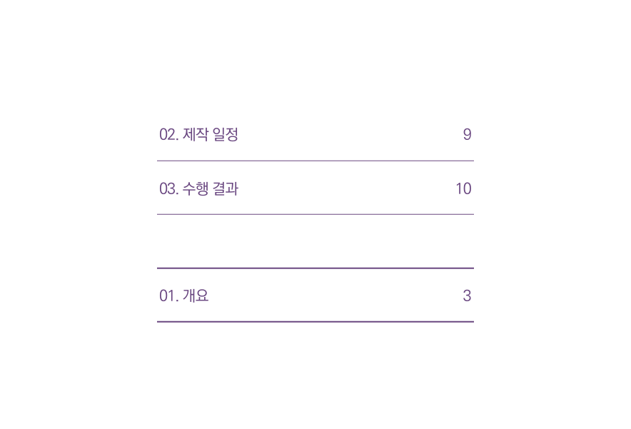




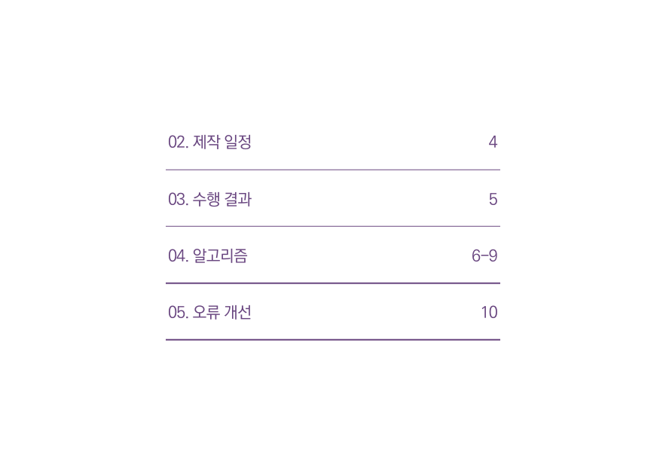






Slide 3






Slide 4



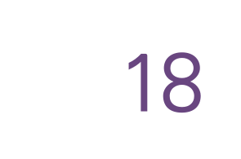



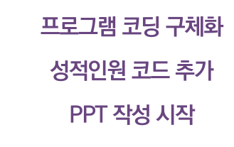




Slide 5




Slide 6

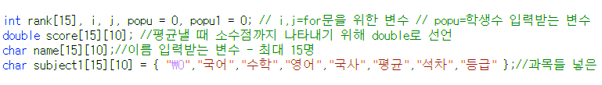
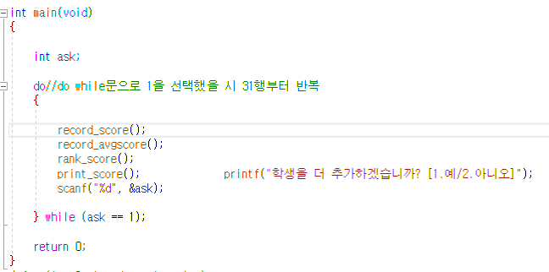
main(void)
Int ask
printf("학생을 더 추가하겠습니까? [1.예/2.아니오]");
record_score();
scanf("%d", &ask);
record_avgscore();
rank_score();
(ask == 1);
Yes
no
print_score();
return 0;
끝

Slide 7
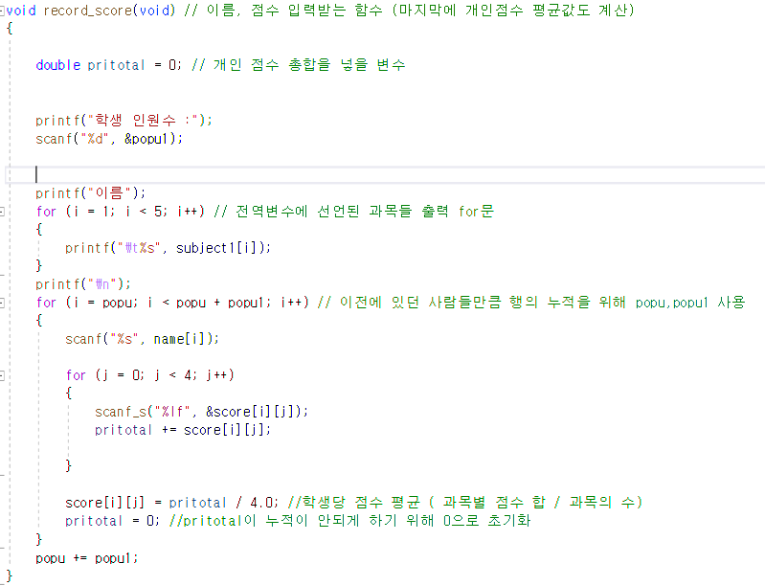
record_score 함수
Double pritotal=0선언
i=popu 선언
(popu 초기값 0)
Yes
I <
popu+popu1
Printf(“학생수 입력)
J = 0 선언
Scanf(“”%d”&popu1) 저장
Scanf (“%s”,name[i])
No
J < 4
Score[i][j] = pritotal / 4
Printf(“학생수 입력)
Yes
I = 0 선언
Pritotal =0
No
scnaf (“lf”,&score[i][j])저장
I<5
I ++
Printf(subject1[i]
Pritotal += score[i][j]
(학생의 4개과목 총점)
Popu += popu1
J ++
Printf(\n)

Slide 8
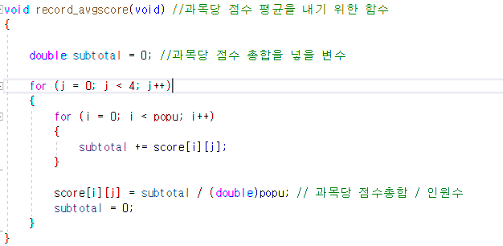
recordavgscore 함수
i=0
Score[i][j]
i < popu
double subtotal = 0
J = 0
Yes
subtotal += score[i][j]
Yes
j < 4
i++
NO
j++
score[i][j] = subtotal / (double)popu subtotal = 0
NO
void print_score(void)

Slide 9
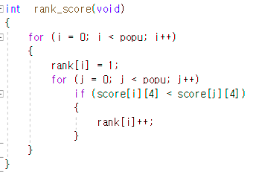
Rank_score 함수
rank[i] = 1;
int rank_score(void)
j = 0;
i = 0;
j < popu
Yes
i < popu;
Yes
score[i][4] < score[j][4]
No
끝
No
No
rank[i]++;
i++
j++

Slide 10
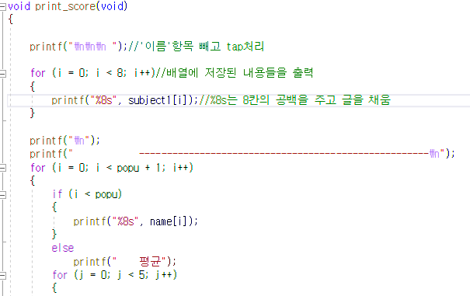
void print_score
(void) 함수
i<popu
void print_score
(void)
printf("\n");
printf(" ---=n);
Yes
Yes
No
No
printf("\n\n\n ");
printf("%8s", name[i]);
printf("평균");
i = 0;
i = 0;
j = 0;
i < popu + 1;
i < 8;
Yes
No
j<5
printf("%8s", subject1[i]);
Printf(“\n\n”)
i++;
끝

Slide 11
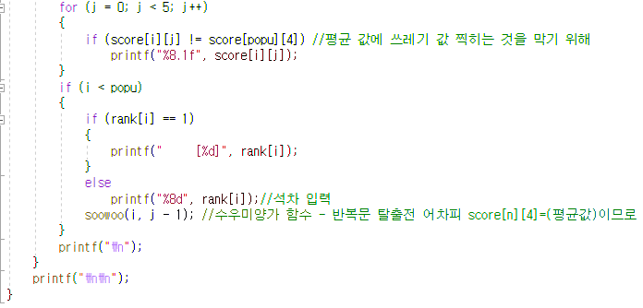
void print_score
(void) 함수
score[i][j] != score[popu][4]
j<5
Yes
No
if (i < popu)
j++
printf("%8.1f", score[i][j]);
Yes
No
rank[i] == 1
No
printf(" [%d]", rank[i]);
printf("%8d", rank[i]
soowoo(i, j - 1);
printf("\n");
i++

Slide 12
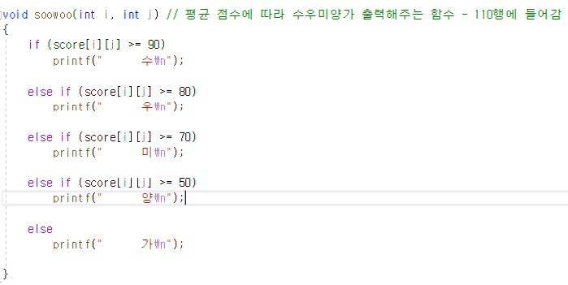
void soowoo
함수
score[i][j] =pritotal / 4.0
(평균 값)
score[i][j]
if
Score[i][j]>=90
Yes
Printf : ‘수’
NO
Else ~ if
Score[i][j]>=80
Yes
Printf : ‘우’
NO
Else ~ if
Score[i][j]>=70
Yes
Printf : ‘미’
NO
Else ~ if
Score[i][j]>=50
Yes
Printf : ‘양’
NO
Else
나머지(50 >Score[i][j])
Printf : ‘가’

Slide 13


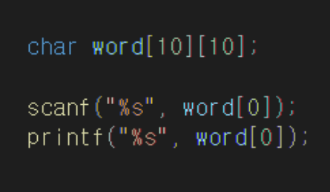



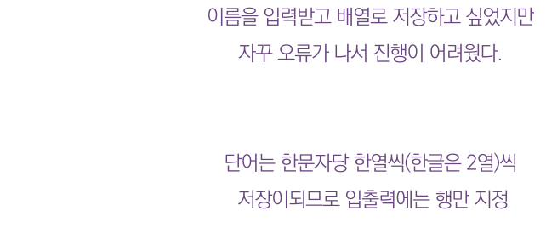
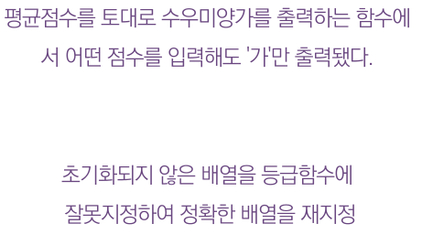
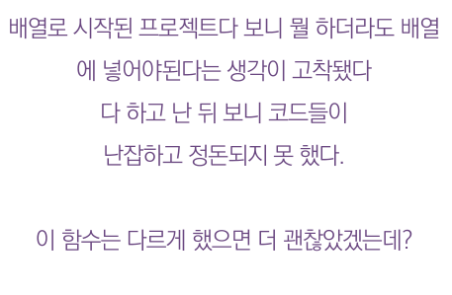







Slide 14





